Slide 1
Stress Analysis on Reddit
R for Data Science Project 1
Melanie McCord
Notes:
Hello, my name is Melanie McCord and this is my data exploration of stress analysis in Reddit posts.

Slide 2
Introduction
For my project, I have done some data exploration of the distributions of the dataset of Reddit posts, their corresponding subreddit, lexical features and sentiment intensity.
My statistical modeling (still in progress) will be chi-squared test of association between label and the other variables.

Slide 3
Background
Stress is a common aspect of modern lives that can result in negative health outcomes.
Being able to predict stress on social media can be beneficial.
Reddit is a social media platform where users post questions and can get advice.
Mining from stress related subreddits can be beneficial to understanding the problem.
Notes:
For example, depression, anxiety, insomnia, and more.

Slide 4
Data Structure and Source
The data was collected by scraping all available posts from 10 subreddits between January 1, 2017 and November 19, 2018, then discarding the posts that were judged by annotators to be unclear as to whether they were stressed.
For each post, we have the text, the sentiment, the label, and some lexical features, syntactic features, social media features.
The data was labeled using 5 human annotators and picking the label that was chosen by the majority of the annotators.
For the purposes of this project, I am only considering the words in the text and the sentiment to determine the label.
Future work may include exploring the other variables and identifying patterns among them.
For more information on the dataset, see this paper: Dreaddit: A Reddit Dataset for Stress Analysis in Social Media

Slide 5
Major Variables I Will Be Exploring
Label: stressed (1) or not stressed (0)
Sentiment: the intensity of negative or positive emotion. This ranges from -1 (completely negative) to 0 (completely neutral) to 1 (completely positive)
Subreddit: the subreddit the post came from (10 subreddits related to stressful topics)
Words: the unique words from each post that occur in the dataset

Slide 6
Research Questions
How does the stress label differ among subreddits?
How can we predict stress given words in the data and lexical features?
Is there an association between stress-related data and subreddits?

Slide 7
Dataset Label Distribution.
Dataset consists of training data with 2838 posts, test data with 715 posts
Sampled from 10 subreddits
Labels are 0 (non-stressed) or 1 (stressed): whether the majority of annotators considered the label to be stressed
Notes:
H

Slide 8
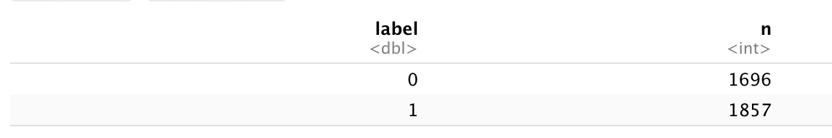
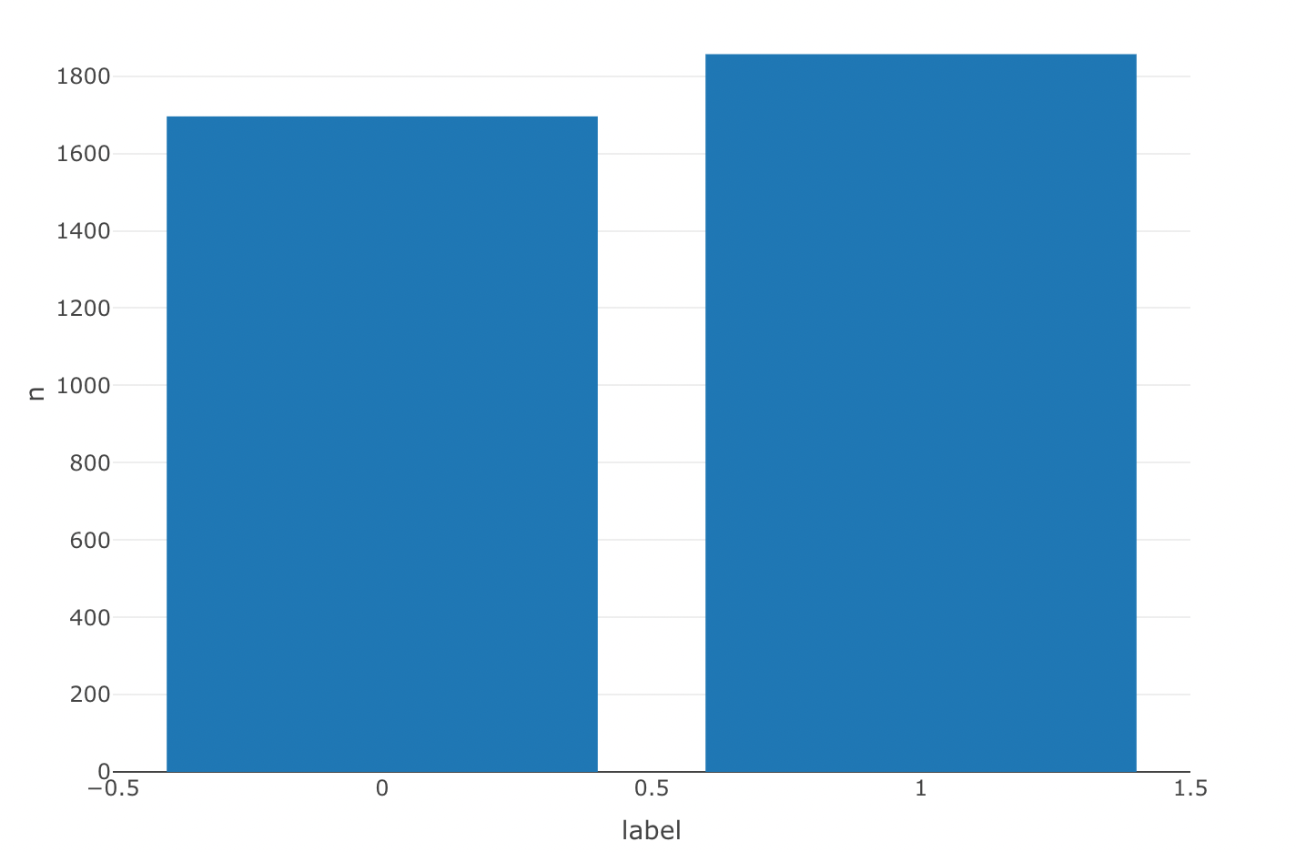
Dataset By Label
Notes:
Here, there is a significantly higher number of stress-related versus non-stress related data, but not heavily imbalanced.

Slide 9
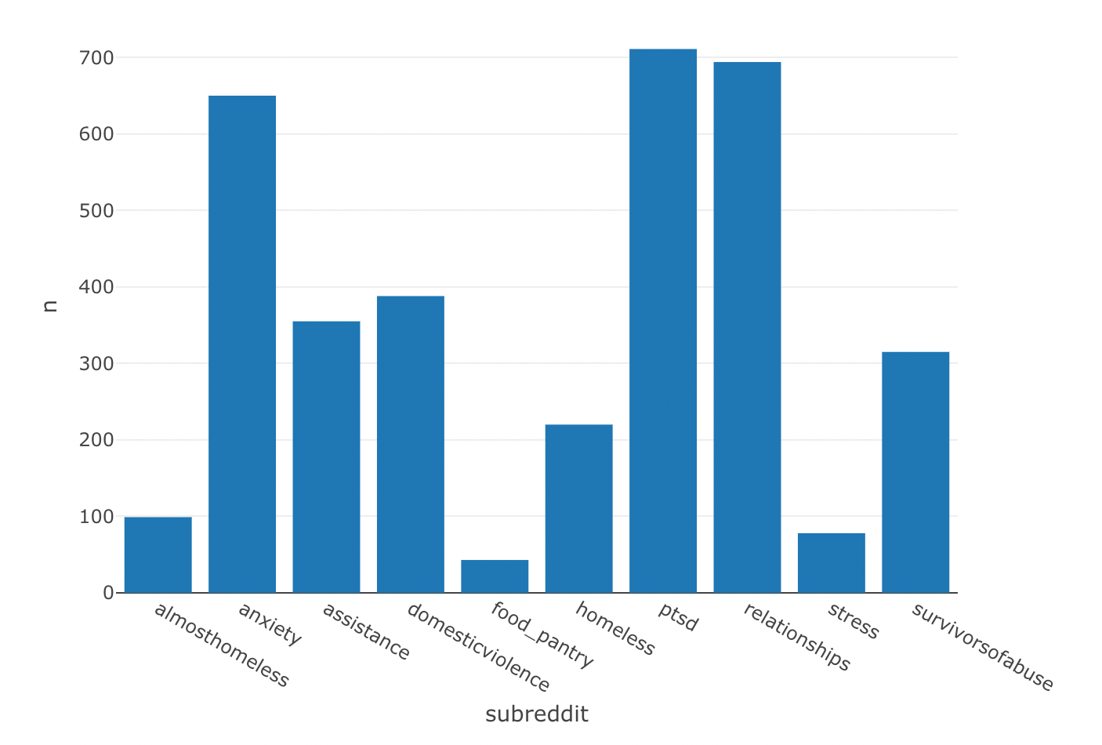
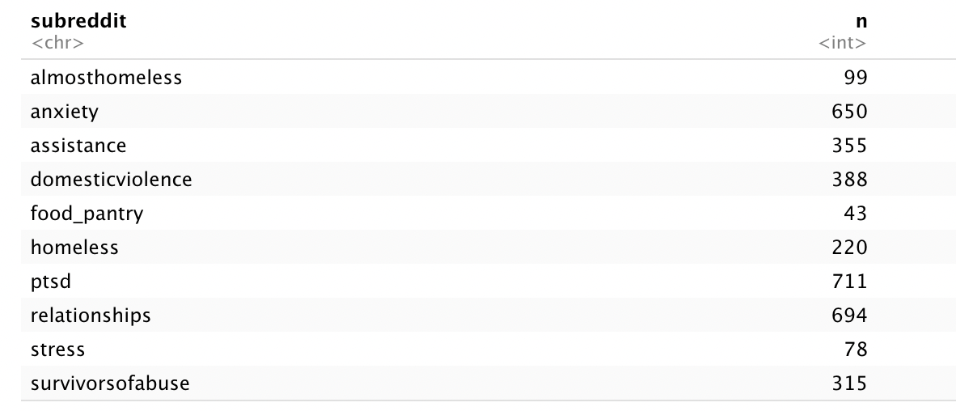
Distribution of Data By Subreddit
Notes:
The subreddit distribution, however, is heavily imbalanced. There are only 43 posts from r/food_pantry, and 694 from r/relationships. This may mean that the model will perform significantly differently by subreddit and is another thing we will have to account for in the statistical analysis. Since not all subreddits are equally active, this may have to do with the sparsity of the posts available within this time frame, or a proportionally higher number of posts from, say food pantry were able to be labeled as stressed or not.

Slide 10
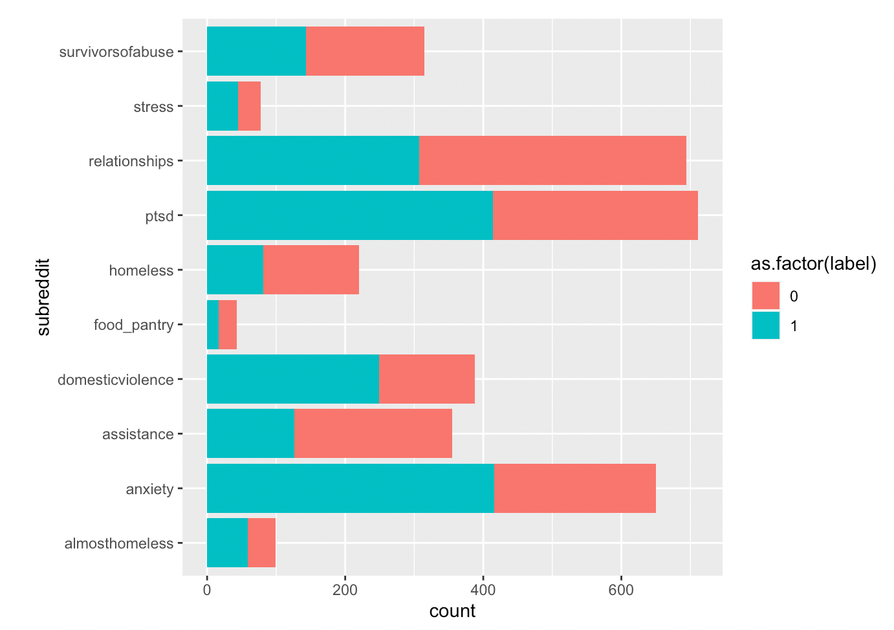
Distribution of Posts by Subreddit and Label
Notes:
Additionally, for each particular subreddit, there are uneven distributions in the percentage of posts that are stress or not stress related. Assistance appears to be imbalanced towards non-stress related posts, whereas domesticviolence is biased towards stress-related posts. One possible explanation could be that although people are seeking advice from these subreddits, assistance may simply be asking what resources are available, whereas domesticviolence or anxiety may be more focused on stressful incidents or needing support.

Slide 11
Special Issues with Text-Related Data
Text data is inherently messy.
Firstly, computers can only process numbers, meaning that any text data needs some way to be converted to numbers.
Some words that commonly appear in text have very little influence on the text. We call these stop words. (Such as “and”, “so”, “to”, etc.)
To a computer, these are all different words:
Cold?
Cold;
Cold
Rare words
High dimensional data (initially had over 12,000 variables, reduced to ~1700 variables)
Notes:
Another detail about the statistical analysis is that since I was primarily focusing on text mining, there were a number of things that I had to consider that are unique to text data. Text data is inherently messy. Firstly, computers can only process numbers, meaning that any text data needs some way to be converted to numbers. When you ask R to predict a categorical variable, what it is really doing is converting it to a number, for example Stress is 1, non-stress is 2, and then using your particular model to convert it to a number. There are a lot of different ways to do this, but the model I chose to focus on is a bag of words model, which counts the number of times a particular word appears and adds each word as a feature. However, in doing so there were some things I needed to clean. Stopwords appear frequently but don’t matter much when understanding the meaning of text. Additionally, punctuation, capitalization, etc causes issues. As part of my data wrangling, I needed to deal with this. Also, some words only appear in one post. For example, one post may ask about resources available in Louisiana, but no other post mentions Louisiana. We need a way to deal with these issues.

Slide 12
Data Wrangling Completed
Converting all words to lowercase
Removing punctuation
Counting the number of times a word appears and adding it as a feature to each post
Removing rare words
Adding an indicator to clarify the difference between “subreddit” as the feature and “subreddit” in the post
Joining the training and test data
Adding the word columns to the original data
Notes:
Converting all words to lowercase ~ to avoid the capitalization issues discussed in the previous slide
Removing punctuation
Bag of words model
Removing rare words ~ this was a fairly tricky data wrangling that involved determining a metric for rare words and then replacing them with a “unk” token
Adding “text_” to each feature to distinguish them from the whole dataset: previously subreddit was having issues given subreddit is also a word that appears in the posts
Joining the training and test data: this was to avoid potential bias in the training and test set
Adding the word columns to the original data: performing a data join to add the bag of words model to the other features.

Slide 13
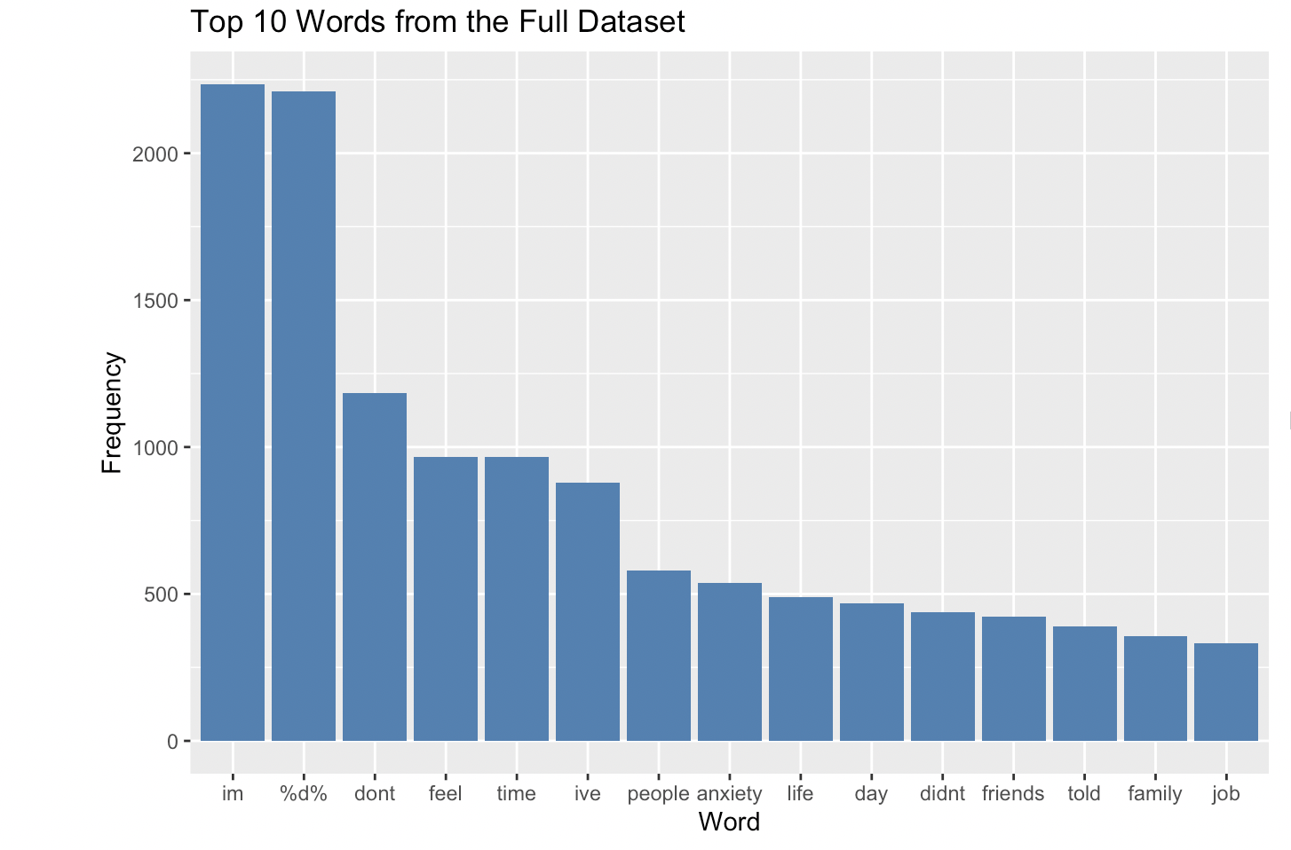
Top Words By Category
Notes:
For the whole dataset, the most common words appear to be neutral, possibly linked to the diversity of posts reflected. Anxiety feel and people appear frequently, which is understandable considering the focus is stress-related subreddits.

Slide 14
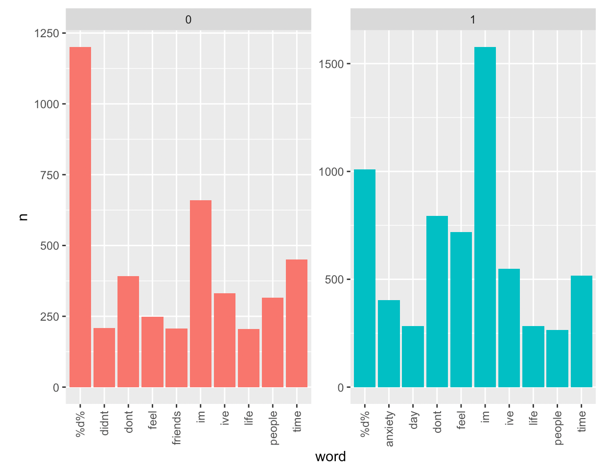
Top 10 Words for Non-stressed versus Stressed
Notes:
The words differ significantly by stressed versus not stressed data. Stress free posts generally talk about feel, friends, life, people, and time. Stress related posts are more likely to talk about anxiety. Day.

Slide 15
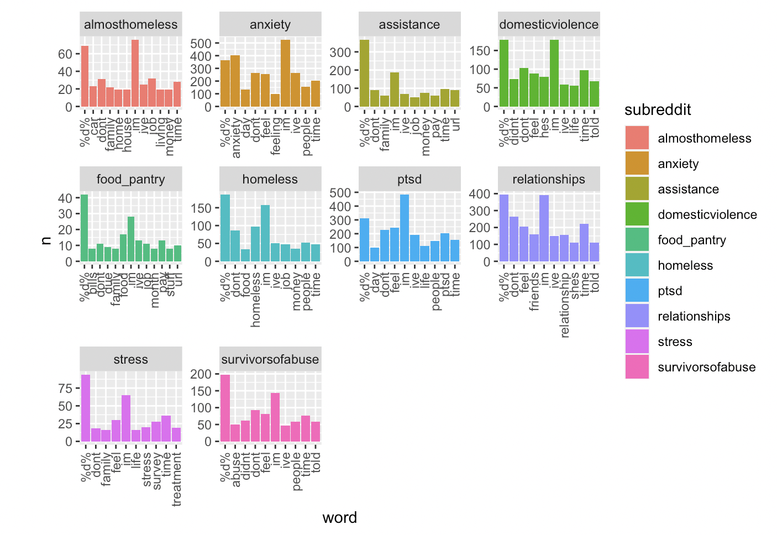
Top 10 Words by Subreddit
Notes:
The top 10 words by subreddit appear to correspond pretty well with the subreddit topic. Since there are 10 distinct subreddits, for a comparison I will only focus on three subreddits: almosthomeless, anxiety, and survivors of abuse. My goal for this visualization is to compare the differences in the top 10 words by subreddit and see how the different subreddits affect it. If possible, I would have liked to do a comparison by subreddit by label, but this visualization will likely not be particularly useful for this. This visualization doesn’t really work because there are too many different graphs. Does anyone have any suggestions for what would be better?

Slide 16
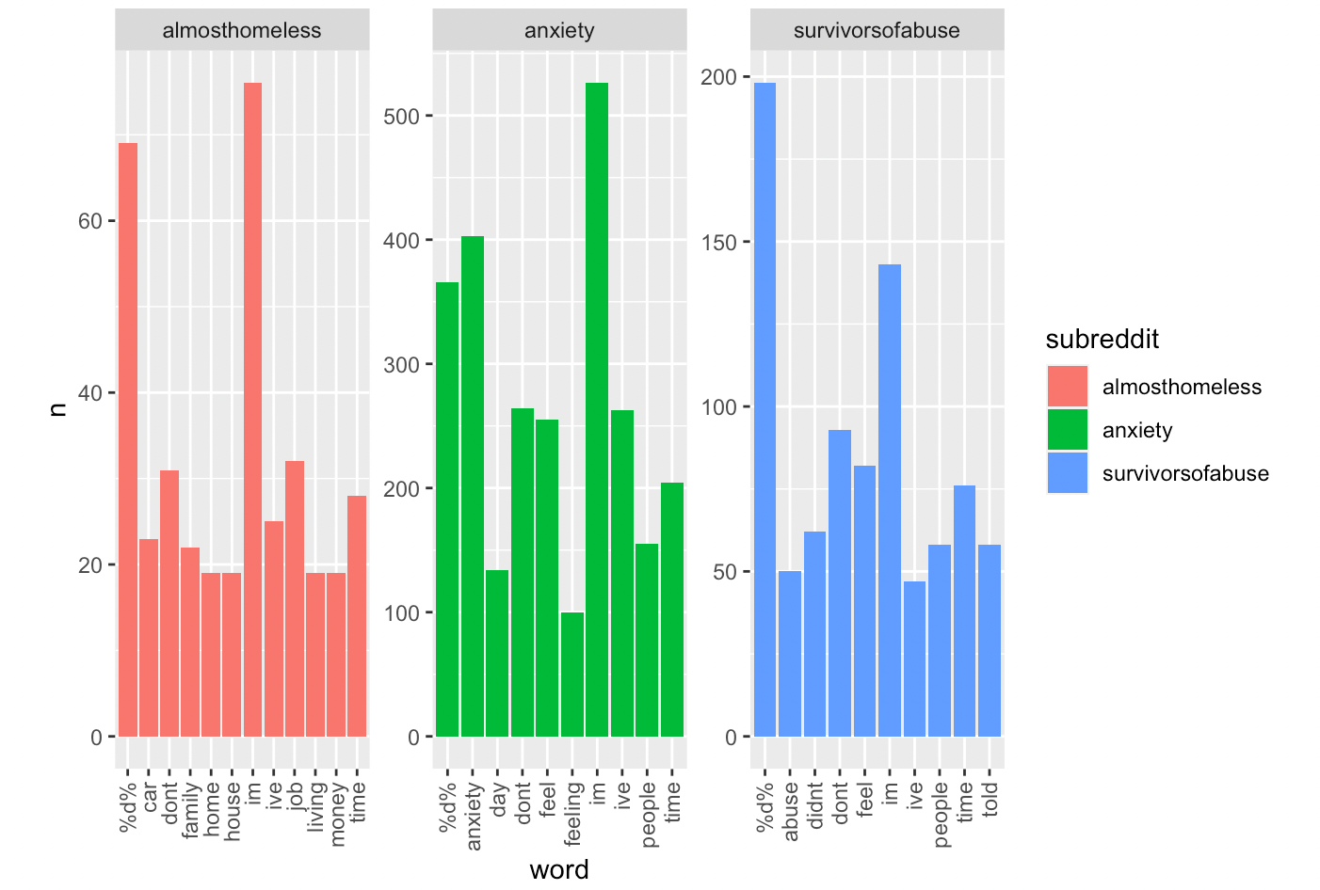
Top 10 Words by Subreddit
Notes:
AlmostHomeless posts tend to focus on car, family, house, job, whereas anxiety tends to focus on anxiety, day, feeling, and survivorsofabuse tends to focus on abuse, feel, and people.

Slide 17
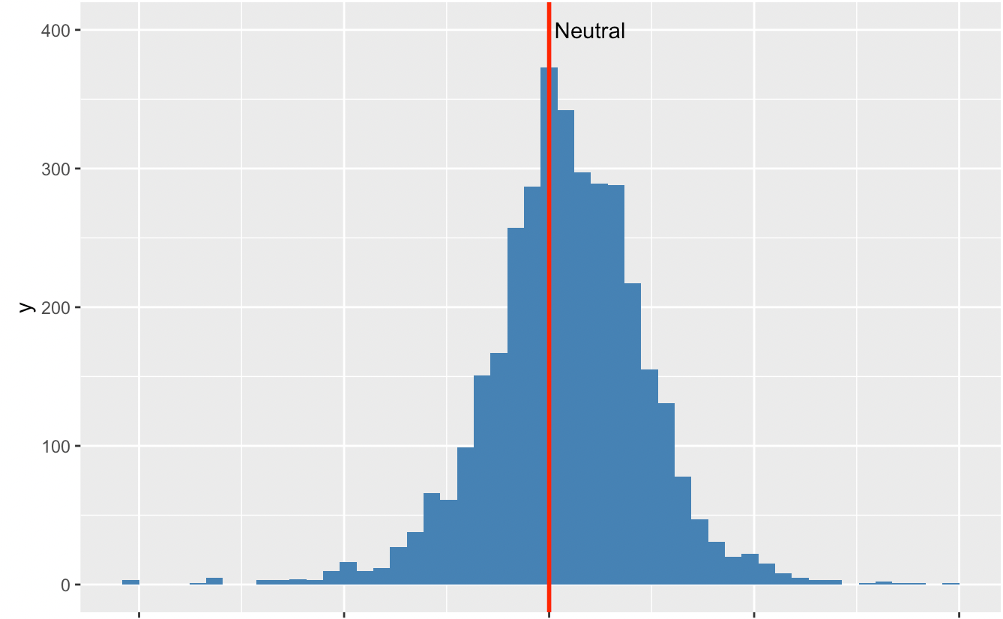
Distribution of Sentiment By Post
Notes:
When we use sentiment to describe posts, we mean a score to determine how negative/neutral or positive some text is. 1 means completely positive, 0 means completely neutral, and -1 means completely negative. It looks like the overall distribution of sentiment is about neutral, with slightly more negative outliers than positive outliers. The red line is at 0, and marks the absolutely positive/negative posts.

Slide 18
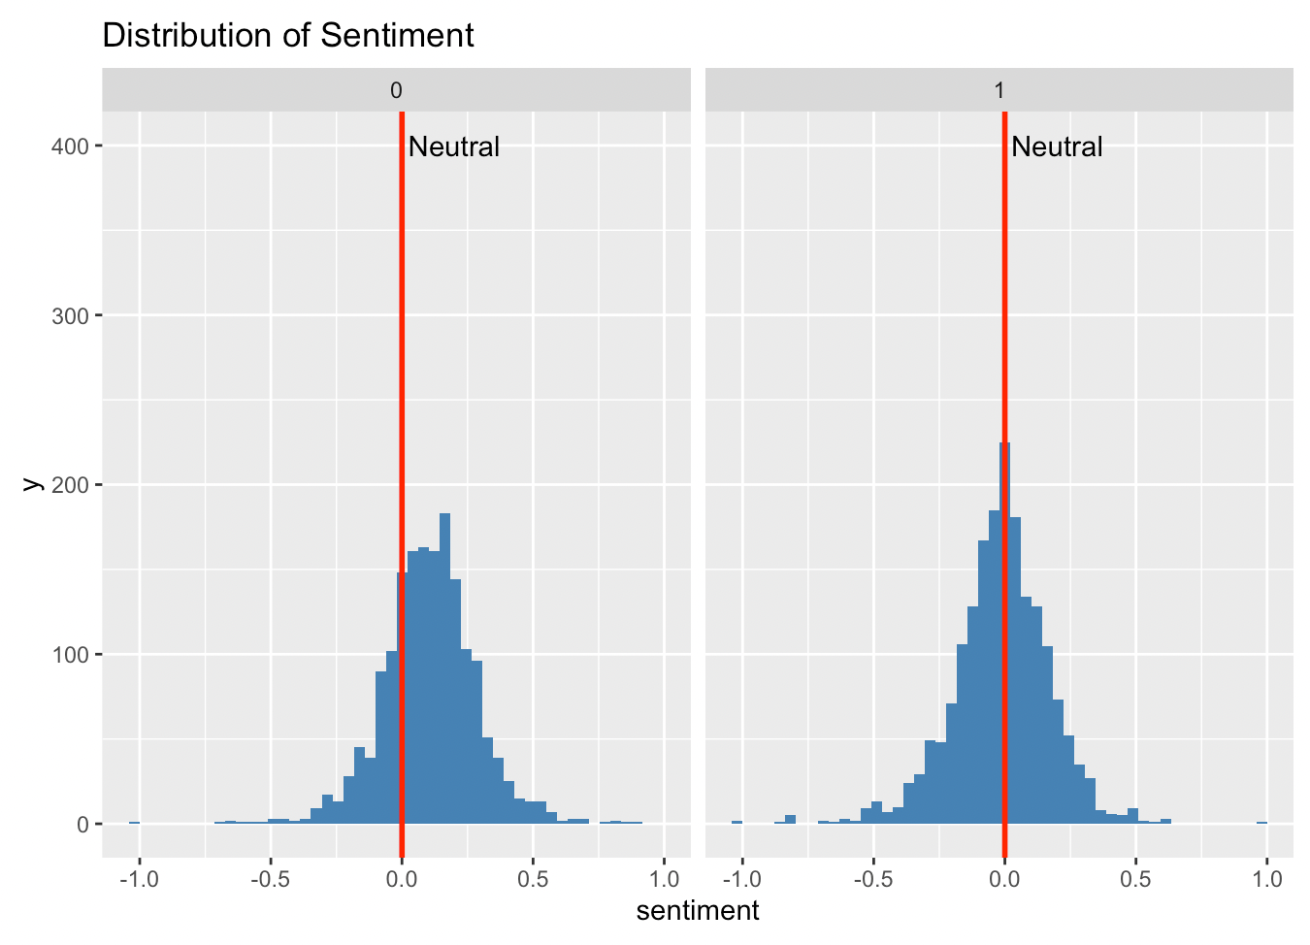
Distribution of Sentiment By Post (Stress or Non-Stressed)
Notes:
The red line represents 0, where the posts are absolutely neutral. The stress free posts are clustered more on the positive side of things and there is more overall spread, whereas the stressed posts are more tightly clustered and more negative.

Slide 19
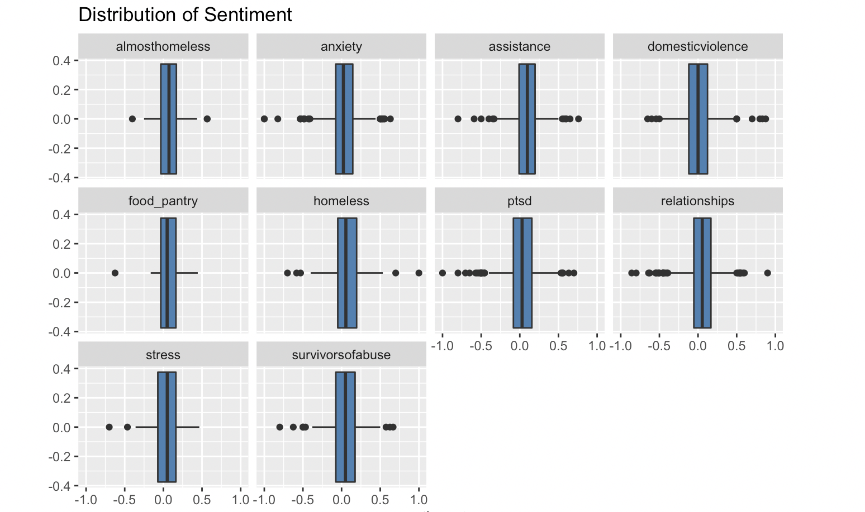
Distribution of Sentiment By Post (By Subreddit)
Notes:
Within each subreddit, there are significant differences depending on the outliers and how overall distribution. Since there are a number of subreddits, I will compare only the ptsd and stress subreddits.

Slide 20
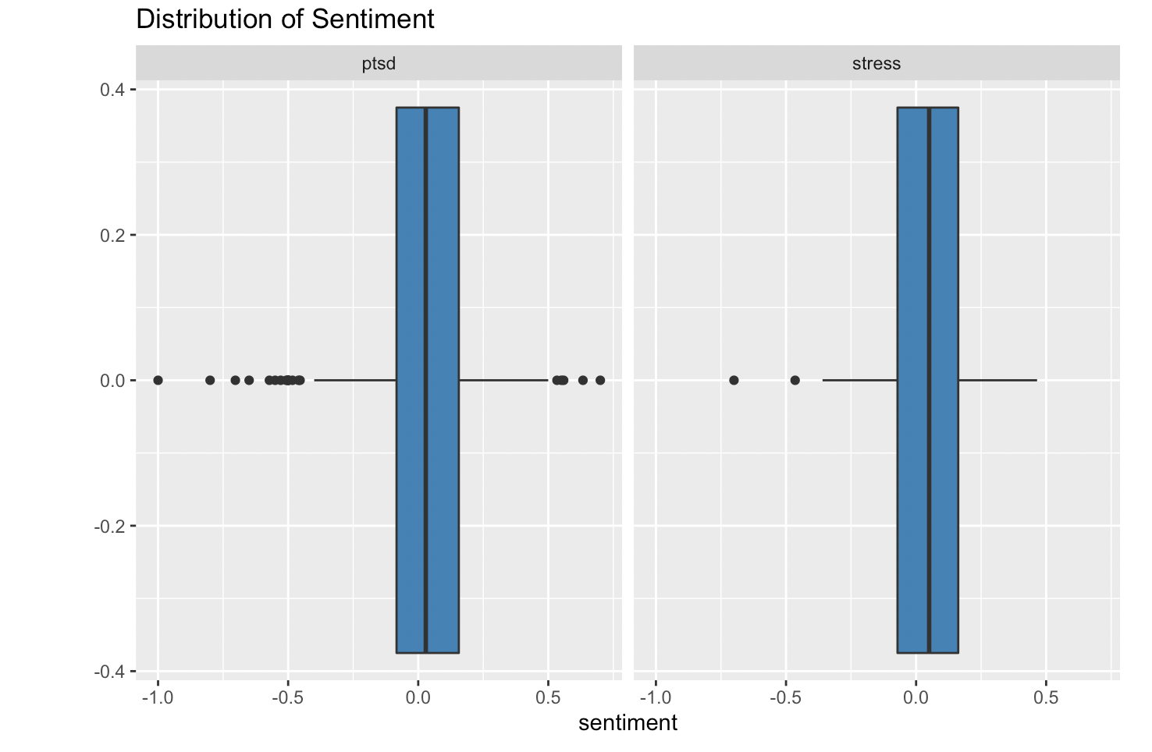
Distribution of Sentiment By Post (By Subreddit)
Notes:
The overall distribution appears to be similar for ptsd and stress, but ptsd appears to have many negative outliers and several positive ones, and stress appears to only have 2 significant outliers that are negative.

Slide 21
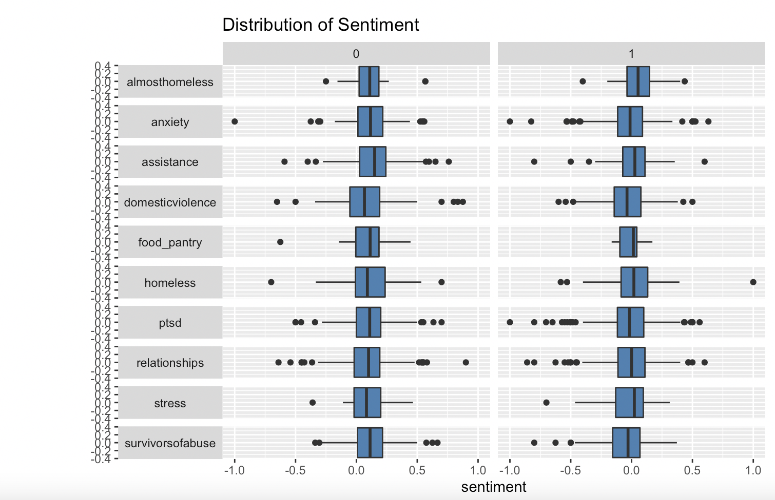
Sentiment By Post (Label and Subreddit)
Notes:
However, if we look by both subreddit and label, we can see significant differences between them. I will look at the assistance and stress subreddits for a detailed comparison, but you can observe that there are significant differences between the outliers and the overall data distribution.
- Ridge plot

Slide 22
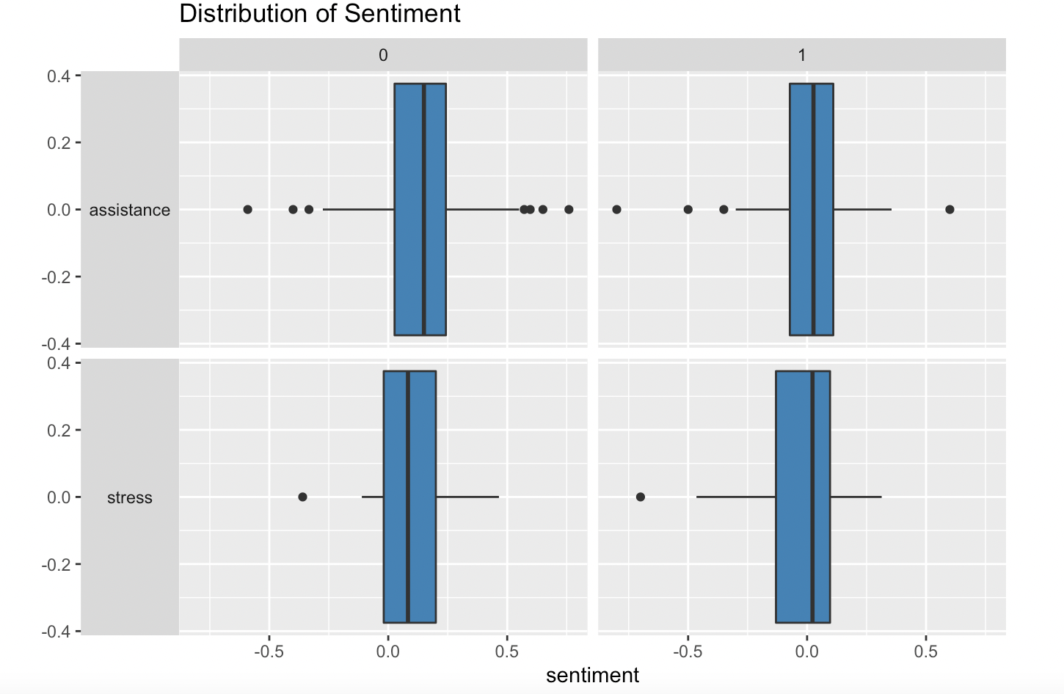
Sentiment By Post (Label and Subreddit)
Notes:
Assistance has a lot more outliers on either end for the non-stressed posts, while its stress related posts have some outliers that are extremely negative and 1 unusually positive. Stress only has one negative outlier for both negative and positive posts and is significantly left skewed for stressed data, whereas almost normally distributed for non-stressed posts.

Slide 23
Work completed
Data wrangling
Visualizations of dataset by label, subreddit, both
Top words by category (overall, subreddit, label)
Distribution of sentiment (overall, subreddit, label, subreddit ~ label)
Feature selection by removing overly correlated variables
Feature selection using rfe (code)

Slide 24
Work to be done
RFE feature selection of the data
Chi-squared test of the differences of label by subreddit and sentiment
Future exploration will be training a decision tree model on this dataset and predicting the label.

Slide 25
Conclusion
By analyzing the sentiment and word distribution patterns in this dataset, we can get an overview of the posts on Reddit.
My overall goal is to be able to evaluate whether a post is stressed and we can do this by evaluating words and sentiment as positive or negative.

